Slide 1


Spotify Music Analysis
Welcome to the world of Spotify music analysis! In this presentation, we will explore the aim, abstract, tools used, dataset description and links, output screenshots, and draw compelling conclusions from our analysis.

Slide 2

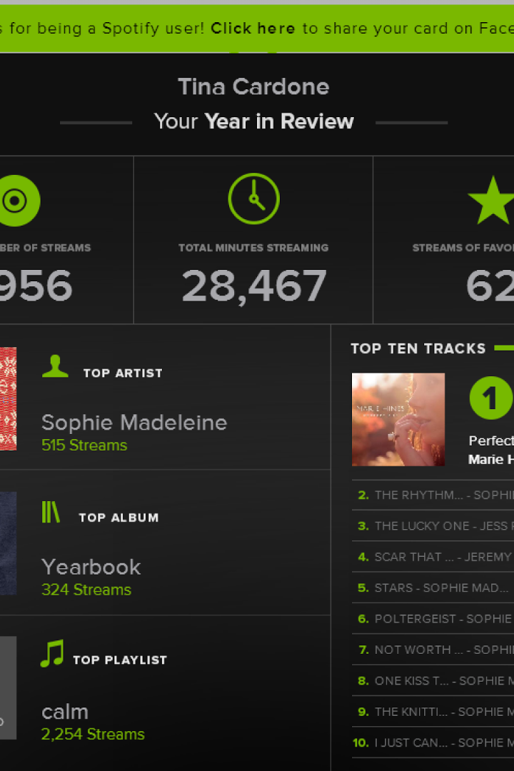
Aim
The Spotify Music Analysis project aims to revolutionize decision-making in the music industry by harnessing advanced data analytics techniques to predict song popularity prior to release. By employing a combination of sophisticated data collection, exploratory analysis, and predictive modeling, the project seeks to provide invaluable insights for music industry professionals, enabling them to make strategic decisions that drive successful music releases and maximize audience engagement

Slide 3

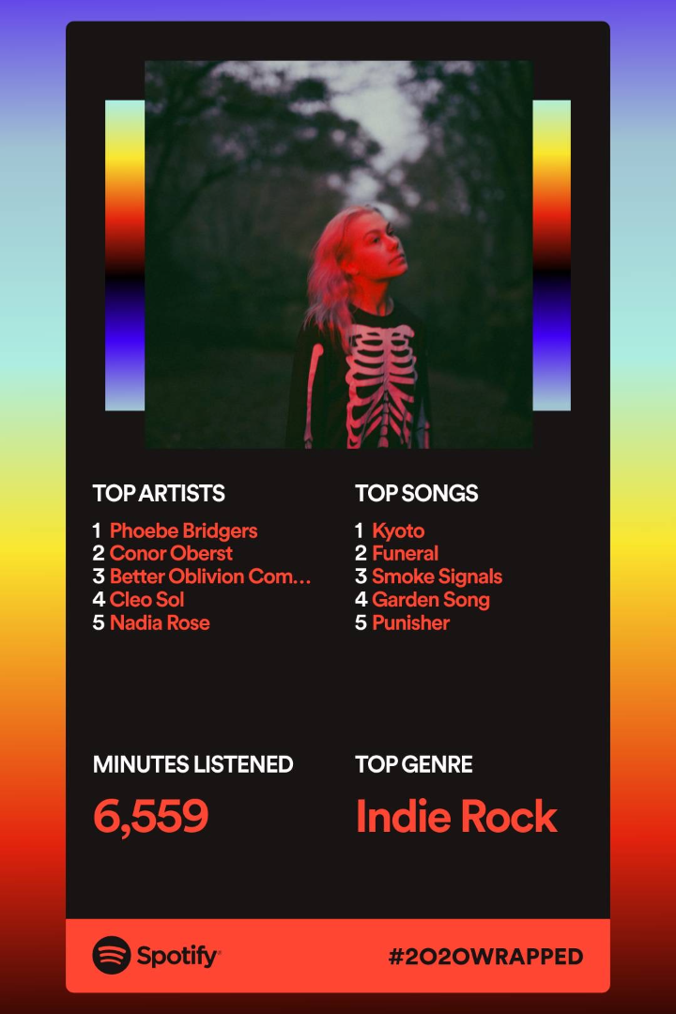
Abstract: Decoding the Melodies of Spotify
The Spotify Music Analysis project is a pioneering initiative that leverages cutting-edge data analytics methodologies to forecast the popularity of songs before their official release. Through the meticulous curation and feature engineering of a comprehensive dataset comprising one million tracks from Spotify, this project explores intricate patterns and relationships within the music industry. By employing state-of-the-art regression models and interactive data visualization dashboards, the project aims to provide an intuitive platform for stakeholders to gauge the potential success of songs, facilitating informed decision-making and enhancing the overall music production and marketing process. This project stands to revolutionize the music industry landscape by empowering stakeholders with the necessary insights to anticipate audience preferences and optimize the impact of their musical creations.

Slide 4
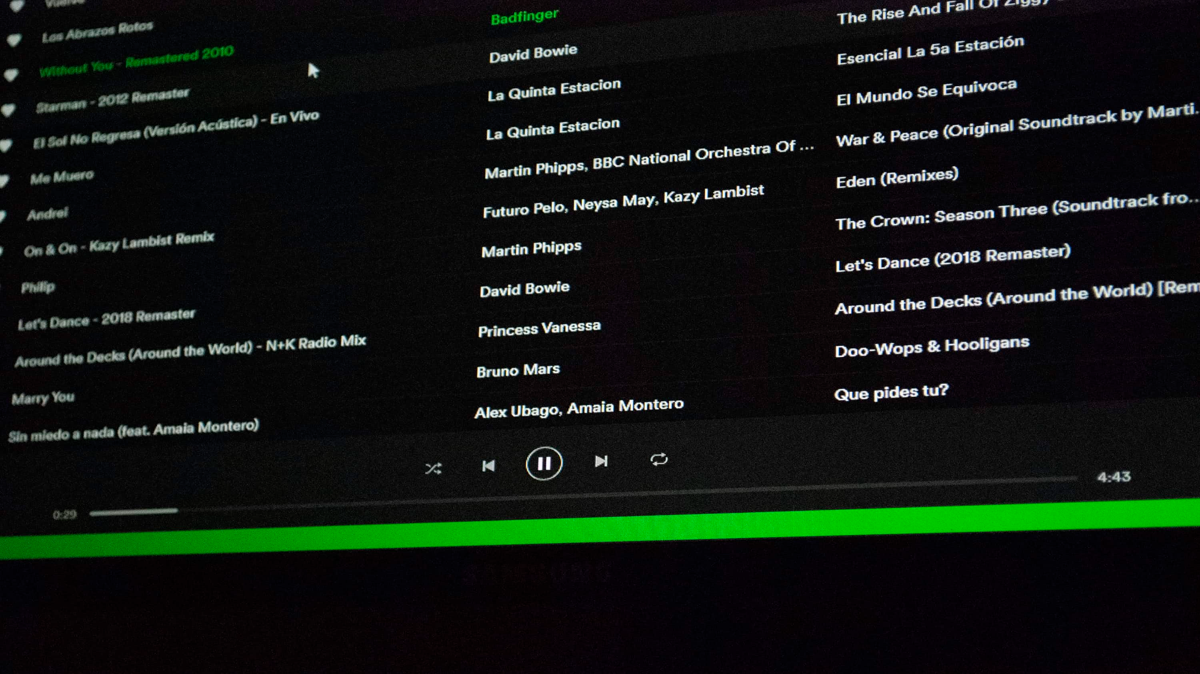
Tools Used: Powering the Music Analysis
Python
Pandas
Matplotlib
Python, a versatile programming language, serves as the backbone of our analysis, enabling us to process, visualize, and extract meaningful insights from the dataset.
Pandas, a powerful data manipulation library, allows us to efficiently work with the dataset, perform calculations, and generate informative statistics.
Matplotlib, a data visualization library, empowers us to create captivating plots and charts to visually represent our findings.
Tableau
Kaggle Notebook
Tableau was used for data visualization and creating interactive dashboards. It allowed for the creation of insightful visualizations that facilitated a better understanding of the dataset and its key insights
The Jupyter Notebook was used as the coding environment for data preprocessing, feature engineering, and regression model implementation. Python libraries and packages were utilized within Jupyter Notebook to conduct data analysis and develop predictive models.

Slide 5


Dataset Description :
The dataset used in this report allows users to access music data provided via APIs. The dataset collected includes about 1 Million tracks with 19 features between 2000 and 2023. Also, there is a total of 61,445 unique artists and 82 genres in the data.. Here is a detailed description of the dataset's columns:
1
Popularity
2
Year
3
Danceability
1. The popularity score of a track on Spotify, ranging from 0 to 100, indicating its overall appeal and listener engagement.
1. The year the track was released, providing temporal context for the analysis and allowing for trend identification over time (2000 to 2023).
A metric representing the suitability of a track for dancing, with values ranging from 0.0 (least danceable) to 1.0 (most danceable).
4
Energy
5
Key
6
Loudness:
A perceptual measure of the intensity and activity of a track, with values from 0.0 (low energy) to 1.0 (high energy).
The key in which the track is composed, represented on a numerical scale from -1 to -11, indicating various musical keys.
The overall loudness of the track in decibels (dB), ranging from -60 (quietest) to 0 (loudest).
7
Mode:
8
Speechiness:
9
Acousticness:
A binary indicator representing the modality of the track, where 1 signifies a major key and 0 indicates a minor key.
The presence of spoken words in the track, with values ranging from 0.0 to 1.0, reflecting the extent to which the track contains spoken vocals.
A confidence measure from 0 to 1 of whether the track is acoustic, where 0 represents non-acoustic and 1 denotes purely acoustic.
10
Instrumentalness:
11
Liveness:
12
Valence:
A metric indicating the extent to which the track contains no vocals, with values ranging from 0.0 to 1.0, where 1.0 indicates a completely instrumental track.
A measure of the presence of an audience in the recording, with values ranging from 0.0 to 1.0, representing the likelihood of live audience presence.
A measure of the musical positiveness conveyed by a track, with values from 0.0 (negative) to 1.0 (positive).
13
Tempo:
14
Time Signature:
15
Duration ms:
The tempo of the track in beats per minute (BPM), providing insight into the overall pace and rhythm of the music.
An estimated time signature of the track, with values ranging from 3 to 7, indicating the number of beats in each bar.
The duration of the track in milliseconds, providing the total length of the song.

Slide 6

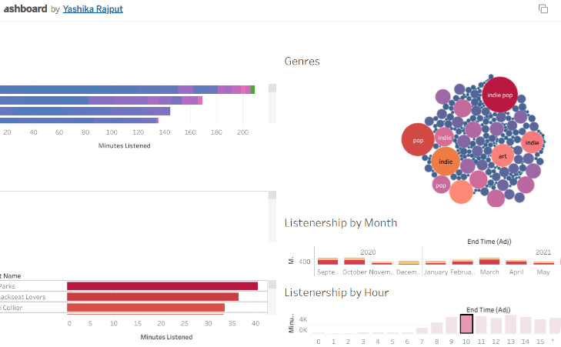
Results and Output Screenshots:

Slide 7


Conclusions: Insights from Spotify Music Analysis
1
Data Insights:
Thorough exploratory data analysis (EDA) using Tableau has revealed critical insights into the dataset, showcasing the distribution of audio features and their correlations. We have identified key audio attributes that significantly impact the popularity of songs, including danceability, energy, and tempo.
2
Model Performance:
We implemented various regression models to predict song popularity, including Linear Regression, Random Forest Regression, Gradient Boosting Regressor, and Neural Network Regression. The model evaluation process identified the most effective model for predicting song popularity accurately.
3
Predictive Insights:
· The project's primary goal was to empower users with the ability to anticipate song popularity before release. The developed models can predict the potential success of songs based on various audio features, providing valuable insights for music industry professionals and artists.
4
Interactive Dashboards:
Interactive Tableau dashboards were created to present the project's findings and insights in a user-friendly and intuitive format. These dashboards enable users to explore the dataset, visualize audio feature trends, and gain insights into potential song popularity based on specific criteria.
5
User Interaction and Deployment:
The user-friendly interface provided by the Tableau dashboards facilitates seamless interaction with the data and predictive models. Users can input song attributes and receive immediate predictions of song popularity, offering a valuable tool for informed decision-making in music production and marketing
6
Continuous Improvement:
· To ensure the ongoing relevance and accuracy of predictions, the project is designed to accommodate continuous updates with new music data. As the music landscape evolves, the models and dashboards can be adapted to reflect emerging trends and preferences.

Slide 8

Thank You
-by Yashika and Tanmay

Slide 9
Link
Spotify_1Million_Tracks (kaggle.com)

